Slide 1

DBMS PROJECT
Hostel Management System
By Group 15

Slide 2
TEAM MEMBERS:
BATTHALA VINOD KUMAR - B191060CS
GOPIKA VINOD - B180215CS
ADWIN M - B180481CS
PUPALWAD GANESH ASHOKRAO - B170537CS
THADI UMESH CHANDRA REDDY - B190411CS

Slide 3
Introduction
This project work proposes a NITC Hostel Management system web application for students so that they can register to hostels.
The main focus of the project is the computerization of allocation process of hostel rooms so we can keep a track of rooms allocated to students from every hostel.

Slide 4
Users
Admin
Hostel Manager
Students
In the system

Slide 5
Add/Remove Hostel Manager
Admin
View all the student details in the system
Allocate students to hostel
Users
Hostel Manager
View the student details
Apply to the hostel
Students
View the available hostel with vacancy

Slide 6
ER Diagram

Slide 7
Entities in the Relation
Student
Hostel Manager
Admin
Hostel
Room

Slide 8
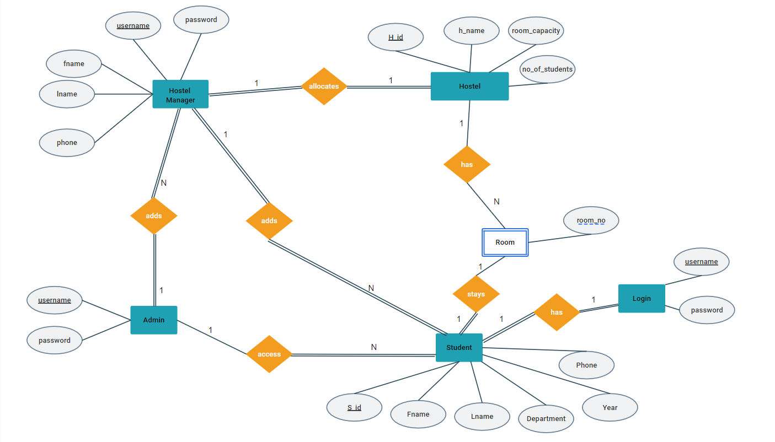

Slide 9
Relational Schema

Slide 10
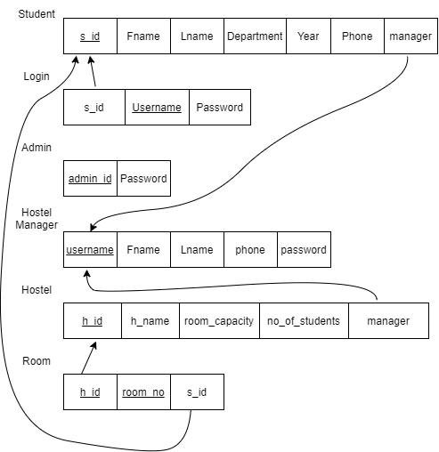

Slide 11
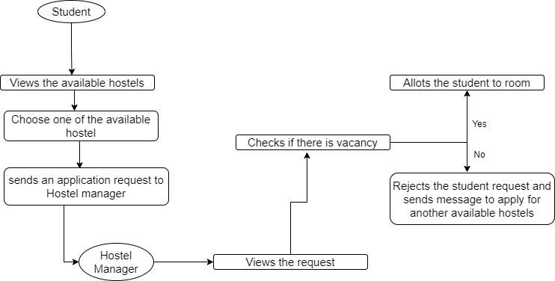
Overview of Product

Slide 12


THANK YOU !

